Slide 1
Evaluating Architectures: ATAM
We evaluate the services that anyone renders to us according to the value he puts on them, not according to the value they have for us.
Friedrich Nietzsche

Slide 2
Analyzing Architectures
Before we consider specific methods for evaluating software architectures will consider some context
Software Architectures (SA) will tell you important properties of a system even before it exists
Architects know the effects (or can estimate) of design (architectural) decisions

Slide 3
Why and When do we Evaluate?
Why evaluate architectures?
  Because so much is riding on it
  Before it becomes the blueprint for the project
  $$$, flaws detected in the architecture development stage save lots of money
When do we Evaluate?
  As early as possible, even during actual development of SA
  The earlier problems are found the earlier and cheaper they can be fixed
  Certainly after the architecture is completed, you should validate it before development
  Later to ensure consistency between design and implementation especially for legacy systems
  Before acquiring a new system.
  The real answer is early and often!

Slide 4
Cost / Benefits of Evaluation of SA
Cost – is the staff time that is required of the participants
  AT&T performed ~300 full scale SA Evaluations
  Average cost 70 staff-days
  SEI ATAM method averages 36 staff-days + stakeholders
Benefit
  AT&T estimated that the 300 Evaluations saved 10% in project costs
  Anecdotal information of Evaluations savings
    Company avoided multi-million dollar purchase when evaluation showed inadequacy
  Anecdotes on Evaluations that should have been done
    Estimate of rewrite of system would take two years; it took three rewrites and seven years
    Large engineering DB system; design decisions prevented integration testing. Cancelled after $20,000,000 invested

Slide 5
Qualitative Benefits
Forced Preparation for the review
  Presenters will focus on clarity
Captured Rationale
  Evaluation will focus on questions
  Answering yields “explanations of design decisions”
  Useful throughout the software life cycle
  After the fact capturing rationale much more difficult “why was that done?”
Early detection of problems with the architecture
Validation of requirements
  Discussion of how well a requirement is met opens discussion
  Some requirements easy to demand, hard to satisfy
Improved architectures
  Iterative improvement

Slide 6
Planned or Unplanned Evaluations
Planned
  Normal part of software life cycle
  Built into the project’s work plans, budget and schedule
  Scheduled right after completion of SA (or ???)
  Planned evaluations are “proactive” and “team-building”
Unplanned
  As a result of some serious problem
  “mid-course correction”
  Challenge to technical authority of Team
  Unplanned evaluations are “reactive” and “tension-filled”

Slide 7
Evaluation Techniques
“Active Design Review,” (1985) Parnas
  Pre-architecture
SAAM (1994/SEI) – SA Analysis Method
ATAM ( / SEI) – Architecture Tradeoff Analysis Method

Slide 8
Basic Reason for Evaluation
Architecture is so vital for the success of any system,
  assess and evaluate it
  identify flaws and risks early,
  mitigate those risks before the costs become too high to manage effectively

Slide 9
Goals of an architectural assessment
In a perfect world, requirements should identify and prioritize business goals, also known as quality attributes, to be achieved by the system.
You need to collect quality attributes of the system by merging:
  the requirements document
  the plans of the project manager.

Slide 10
Next Steps…
After the architectural evaluation, you should:
Know whether the current architecture is suitable for achieving the quality attributes of the system or get a list of suggested changes for achieving the quality attributes of the system.
Get a list of the quality attributes which you will achieve fully and those you will only partially achieve.
Get a list of quality attributes that have associated risks.
Gain a better understanding of the architecture and the ability to articulate it.

Slide 11
Architecture evaluation methods
After extensive research, the Carnegie Mellon Software Engineering Institute (SEI) has come up with three architecture evaluation methods:
  Architecture Tradeoff Analysis Method (ATAM)
  Software Architecture Analysis Method (SAAM)
  Architecture Review For Intermediate Design (ARID)
In many expert opinions, ATAM is the best method of the three and is the one I will discuss in more detail.

Slide 12
ATAM
According to the SEI, to conduct a detailed evaluation, you should divide the evaluation process into the following steps:
Presentation
Analysis
Testing
Report

Slide 13
Presentation
During this phase of ATAM, the project lead presents the process of architectural evaluation, the business drivers behind this project, and a high-level overview of architectures under evaluation for achieving the stated business needs.

Slide 14
Analysis
In the analysis phase, the architect discusses different architectural approaches in detail, identifies business needs from requirement documents, generates a quality attribute tree, and analyzes architectural approaches.

Slide 15
Testing
This phase is similar to the analysis phase. Here, the architect would identify groups of quality attributes and evaluate architectural approaches against these groups of attributes.

Slide 16
Report
During the report phase, the architect puts together in a document the ideas, views collected, and the list of architectural approaches outlined during the previous phases.

Slide 17
Architecture Tradeoff Analysis Method (ATAM)
“We evaluate the services that anyone renders to us according to the value he puts on them, not according to the value they have for us.” --- Friedrich Nietzche
Evaluating an architecture is a complicated undertaking.
  Large system ➔ large architecture
  ABC + Nietzche’s quote yields:
    a computer system is intended to support business goals and
    Evaluation needs to make connections between goals and design decisions
  Multiple stakeholders ➔ acquiring all perspectives requires careful management

Slide 18
ATAM –Cont’d
ATAM is based upon a set of attribute-specific measures of the system
Analytic measures, based upon formal models
  Performance
  Availability
Qualitative measures, based upon formal inspections
  Modifiability
  Safety
  security

Slide 19
ATAM Benefits
clarified quality attribute requirements
improved architecture documentation
documented basis for architectural decisions
identified risks early in the life-cycle
increased communication among stakeholders

Slide 20
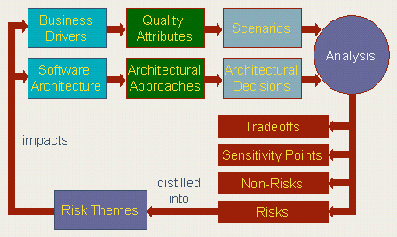
Conceptual Flow ATAM
Ref: http://www.sei.cmu.edu/ata/ata_method.html

Slide 21
Participants in ATAM
The evaluation team
Project decision makers
Architecture stakeholders

Slide 22
Outputs of the ATAM
A concise presentation of the architecture
Articulation of the business goals
Quality requirements in terms of a collection of scenarios
Mapping of architectural decisions to quality requirements
A set of identified sensitivity and tradeoff points
A set of risks and non-risks
A set of risk themes

Slide 23
Phases of the ATAM
Phase Zero
  Partnership and preparation
Phase One
  Evaluation
Phase Two
  Evaluation continued
Phase Three
  Follow-up

Slide 24
Steps of Evaluation Phase One
Step 1 : Present the ATAM
Step 2 : Present business drivers
Step 3 : Present architecture
Step 4 : Identify architectural approaches
Step 5 : Generate quality attribute utility tree
Step 6 : Analyze architectural approaches

Slide 25
Step 1: Present the ATAM
The evaluation team presents an overview of the ATAM including
  The ATAM steps
  Techniques
    Utility tree generation
    Architecture elicitation and analysis
    Scenario brainstorming and mapping
  Outputs
    Architectural approaches
    Utility tree
    Scenarios
    Risk vs. “Non-risk”
    Sensitivity points tradeoffs

Slide 26
Step 2: Present Business Goals
Business Representatives describe:
  The system’s most important (high-level) functions
  Any relevant technical, managerial, economic, or political constraints
  The business goals and context as they relate to the project
    Architectural driver: quality attributes that shape the architecture
    Critical requirements: most important quality attributes for the success of the software
  The major stakeholders

Slide 27
Step 3: Present Architecture
Software Architect presents:
  An overview of the architectures
  Technical constraints such as OS, hardware and languages
  Other interfacing systems of the current system
  Architectural approaches used to address quality attributes requirements.
Important architectural information
  Context diagram
  Views: E.g.
    Module or layer view
    Component and connector view
    Deployment view

Slide 28
Step 3: Present Architecture- Cont’d
  Architectural approaches, patterns, tactics employed, what quality attributes they address and how they address those attributes
  Use of COTS (Component-off-the-shelves) and their integration
Evaluation Team begins probing and capturing risks
  Most important use case scenarios
  Most important change scenarios
  Issues/risk w.r.t. meeting the given requirements

Slide 29
Step 4: Identify Architectural Approaches
Catalog the evident patterns and approaches
  Based on step 3
  Start to identify places in the architecture that are keys for realizing quality attributes requirements
  Identify any useful architectural patterns for the current problems
    E.g. Client-server, publish-subscribe, redundant hardware

Slide 30
Step 5: Generate Quality Attribute Utility Tree
Utility tree
  Is a top-down tool to refine and structure quality attributes requirements.
    Select the general, important quality attributes to be the high-level node
    E.g. performance, modifiability, security and availability.
    Refine them to more specific categories
    All leaves of the utility tree are “scenarios”.
    Prioritize scenarios
      Important first, difficult to achieve first, and so on.
    Importance with respect to system success
      – High, Medium, Low
    Difficulty in achieving
      High, Medium, Low
    (H,H), (H,M), (M,H) most interesting
  Present the quality attribute goals in detail

Slide 31
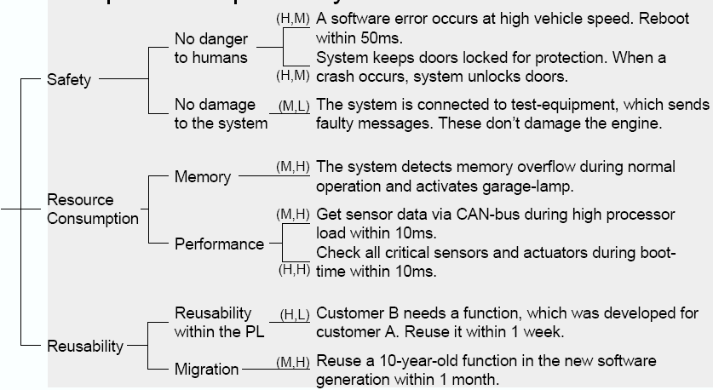
Step 5: Generate Quality Attribute Utility Tree (Example)

Slide 32
Step 6: Analyze Architectural Approaches
Examine the highest ranked scenarios
The goal is for the evaluation team to be convinced that the approach is appropriate for meeting the attribute-specific requirements
Scenario walkthroughs
Identify and record a set of sensitivity points and tradeoff points, risks and non-risks
  Sensitivity and tradeoff points are candidate risks

Slide 33
Sensitivity Point, Tradeoff Points, Risks and non-Risks in Step 6
Sensitivity points
  Property of components that are critical in achieving particular quality attribute response
  E.g., security: level of confidentiality vs. number of bits in encryption key
Tradeoff points
  Property that is sensitivity point for more than one attribute
  E.g., encryption level vs. security and performance, in particular
Risks
  Potentially problematic architectural decisions. (e.g. test by unacceptable values of responses)
Non-Risk
  Good architectural decision.

Slide 34
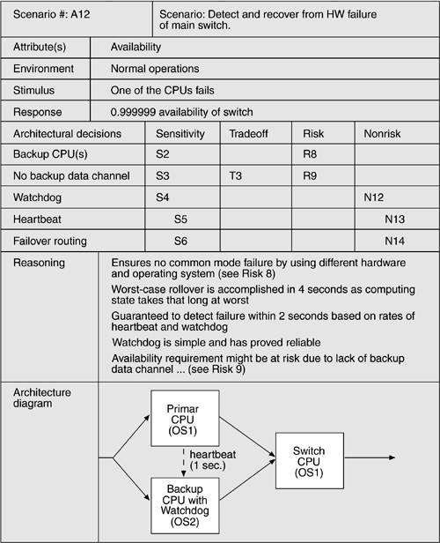

Slide 35
Next time…
Continue phases.
Present a case study.

Slide 36
The essentials
Architectural evaluation is an essential part of system development. Here, we have emphasized the importance of architecture and outlined a formal method for evaluating architecture in ATAM.
Architectural evaluation is important for the success of all systems, irrespective of size. But, normally, it becomes more significant to use formal architectural evaluation methods in medium to large-scale projects.

Slide 37
References
  Evaluating Software Architectures: Methods and Case Studies, by Paul Clements, Rick Kazman, and Mark Klein. (Chapter 11)
  CBAM (2001/SEI) – Cost Benefit Analysis Method (Chapter 12)
  Software Architecture in Practice, Len Bass, Paul Clements, Rick Kazman (Chapter 11)

